Slide 1
A Cheap Christian Character

Slide 2
“A cheap Christian character works more harm in the world than the character of a worldling; for professed Christians mislead others by professing to represent Him whose name they assume.”
-LT 2, 1895

Slide 3
PAPACY

Slide 4
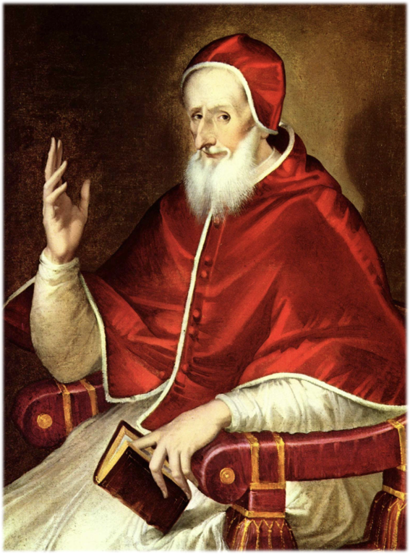
“The Pope and God are the same, so he has all power in Heaven and earth.”
Pope Pius V,

Slide 5
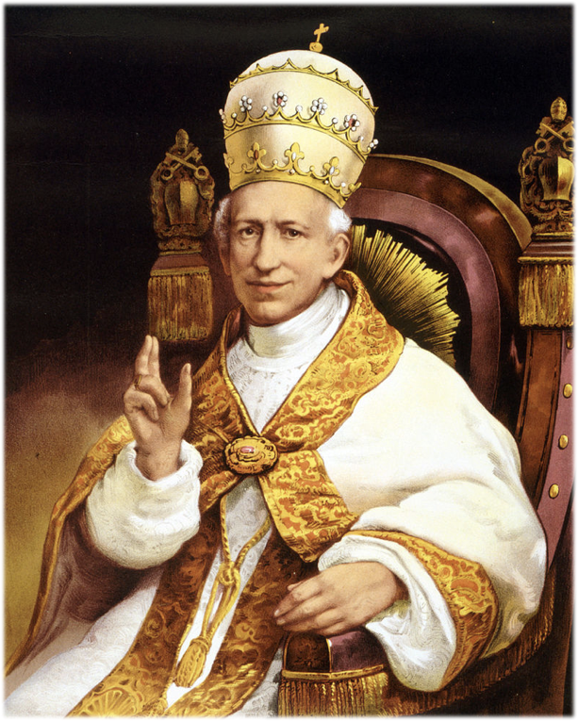
“We hold upon this earth the place of God Almighty.”
Pope Leo XIII

Slide 6
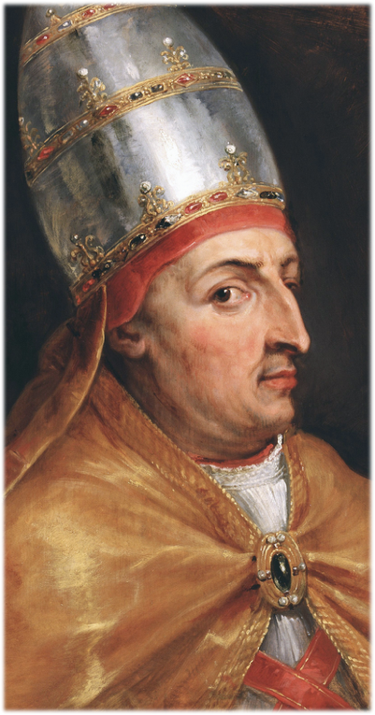
“I am able to do almost all that God can do. What therefore, can you make of me but God?”
Pope Boniface VIII

Slide 7
“I alone… am the successor of the apostles, the vicar of Jesus Christ. I am the way, the truth, and the life…”
Pope Pius IX

Slide 8
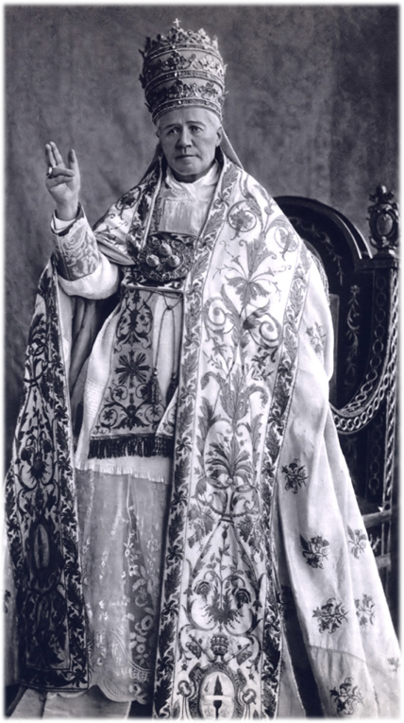
“The Pope is not simply the representative of Jesus Christ. On the contrary, he is Jesus Christ Himself, under the veil of the flesh.”
Pope Pius X

Slide 9
How much harm has the Papacy done?

Slide 10
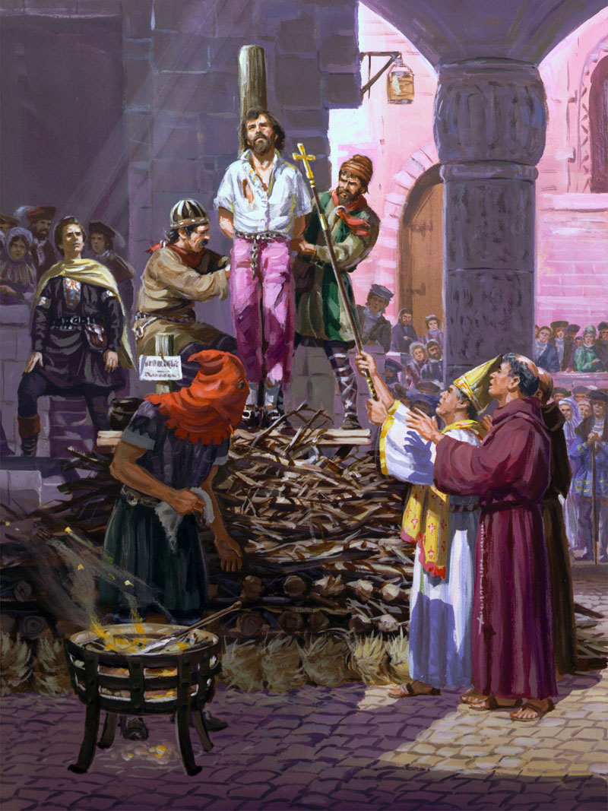
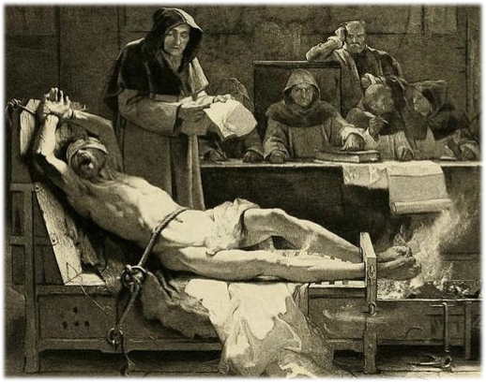
50 Million People Died
"History of Romanism,”
pp. 541, 542. 1871

Slide 11
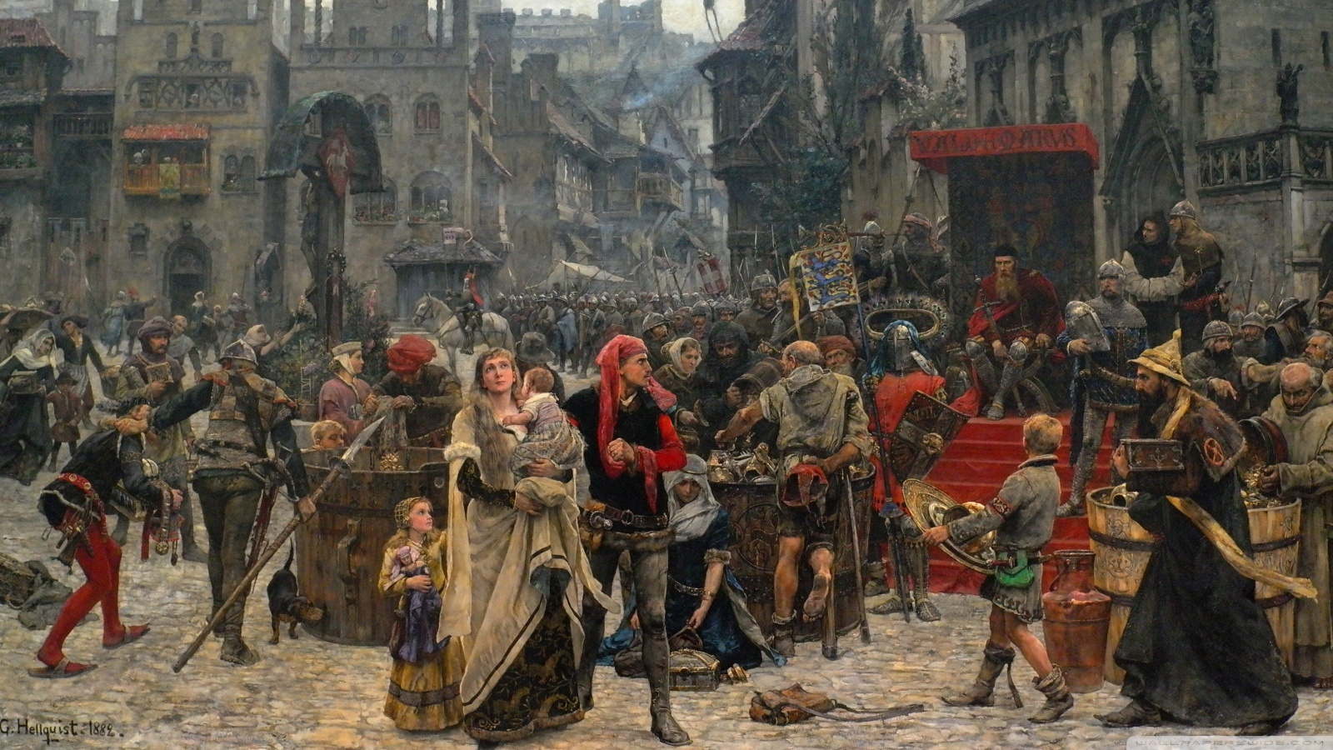
Dark Ages

Slide 12
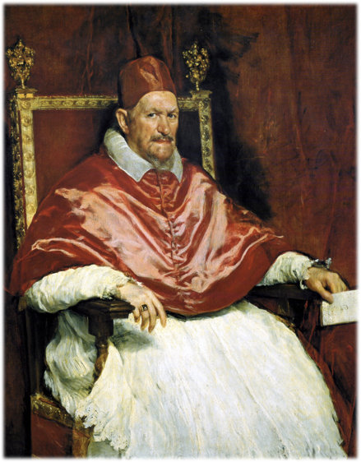
Bible was outlawed

Slide 13
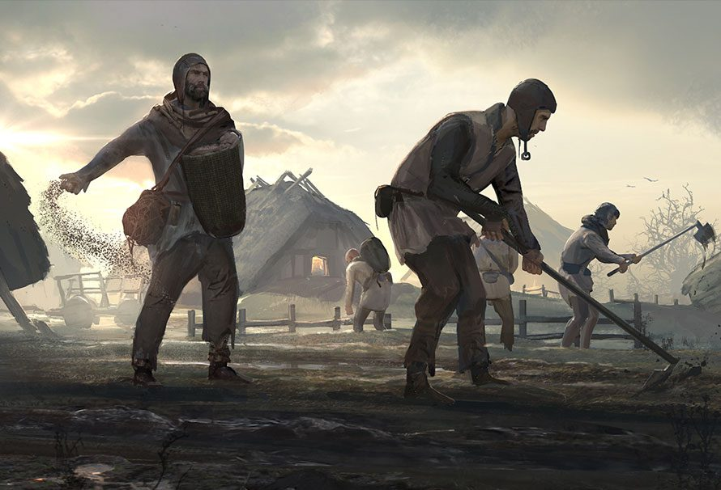
Lack of scientific and cultural advancement

Slide 14
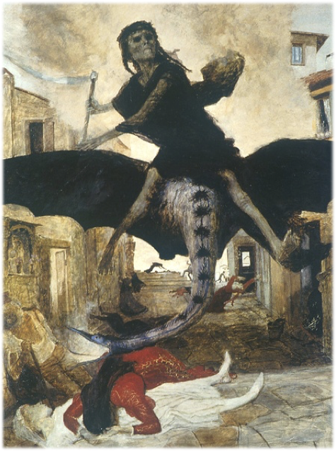
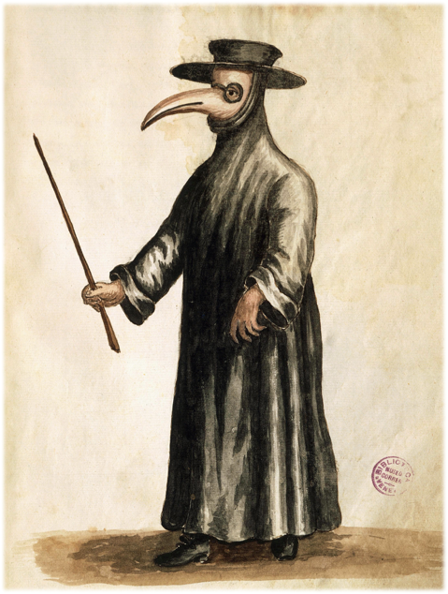
Estimated 200 million people perished!

Slide 15
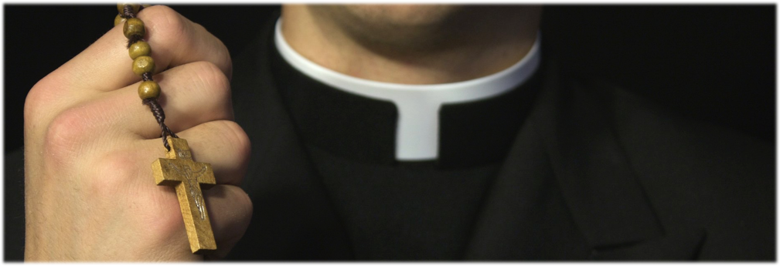
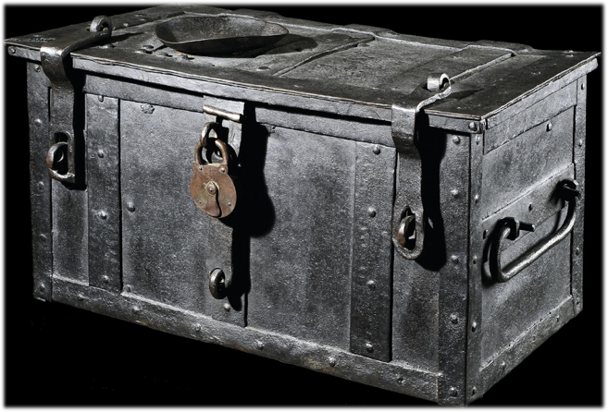

Slide 16
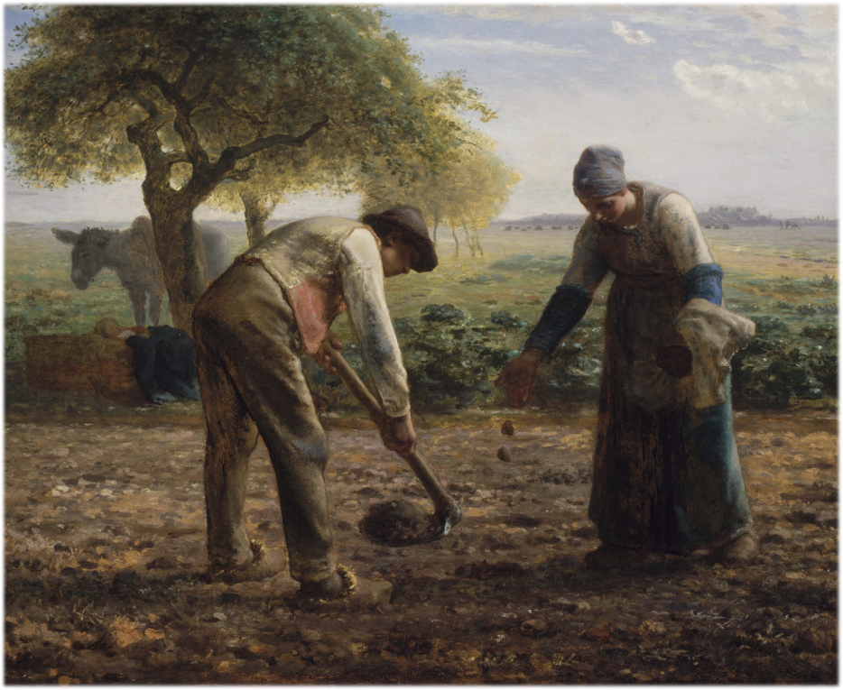

Slide 17
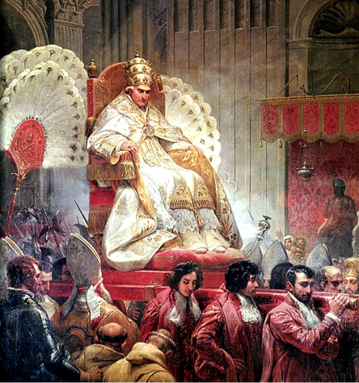

Slide 18
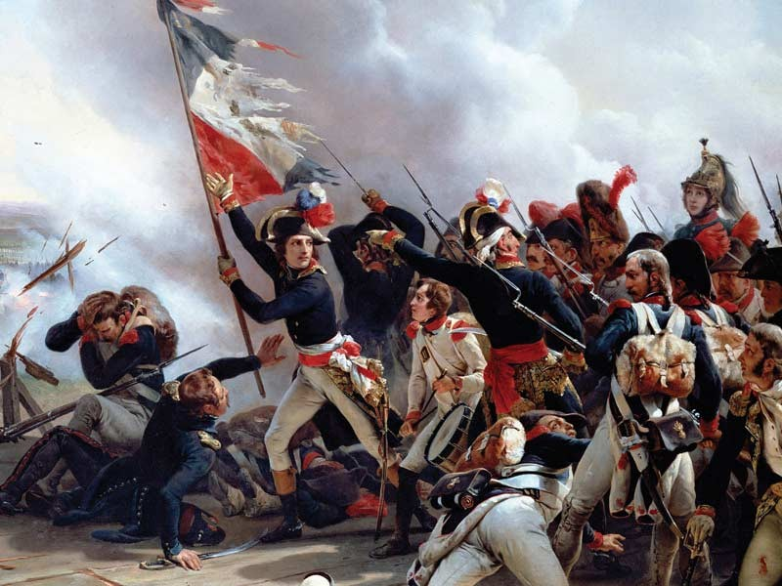

Slide 19
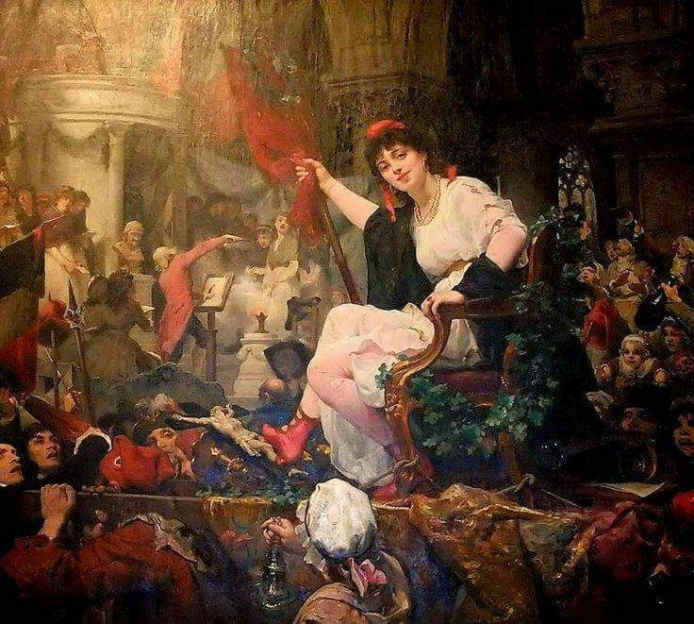

Slide 20
“It was popery that had begun the work which atheism was completing. The policy of Rome had wrought out those conditions, social, political, and religious, that were hurrying France on to ruin….Rome had misrepresented the character of God, and perverted his requirements, and now men rejected both the Bible and its Author.”
GC 276

Slide 21
“A cheap Christian character works more harm in the world than the character of a worldling.”
- Testimonies for the Church 9:21

Slide 22
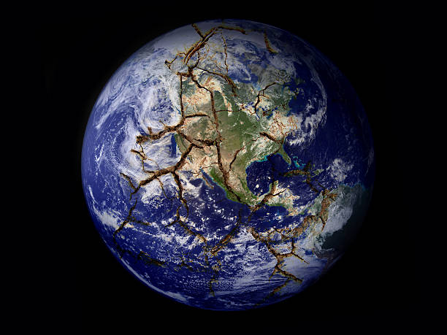
Cheap Christian Character brings….
Death
Misery
Unbelief

Slide 23
Could the same be true for God’s Church?

Slide 24
What’s the MAIN reason people leave the church?

Slide 26
Galatians 5:22-23

Slide 27
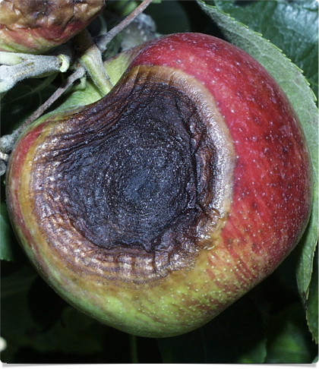
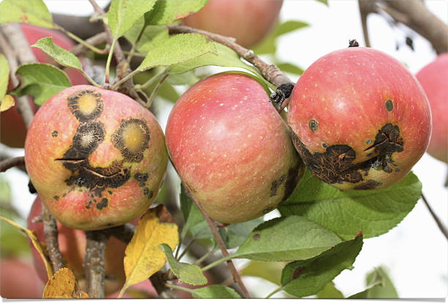
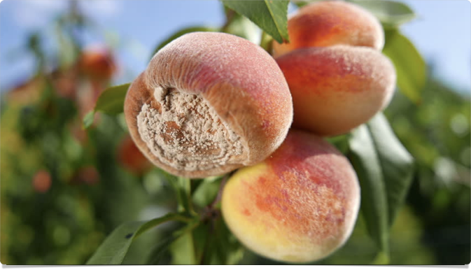
Unforgiveness
Impatience
Unkindness
Wickedness
Doubt
Complaining
Pride
Selfishness
Intemperance

Slide 29
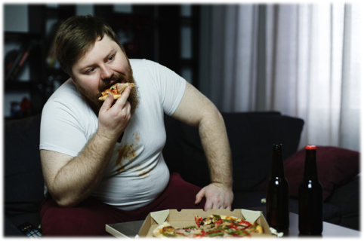

Slide 30
Death
Misery
Unbelief

Slide 31
Revelation 3:17
“Because thou sayest, I am rich, and increased with goods, and have need of nothing; and knowest not that thou art wretched, and miserable, and poor, and blind, and naked:”

Slide 32
Romans 7:24
“O wretched man that I am! who shall deliver me from the body of this death?”

Slide 33
Romans 7:14-15
“For we know that the law is spiritual: but I am carnal, sold under sin. For that which I do I allow not: for what I would, that do I not; but what I hate, that do I.”

Slide 34
Carnal Mind

Slide 35
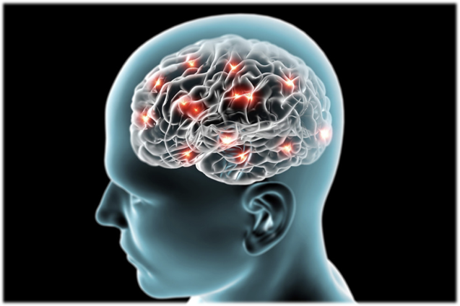
Carnal Christian Character
Cheap Christian Character

Slide 37
Symptoms of Carnal Nature:
“Evil thoughts, hatred, covetousness, wickedness, deceit, lasciviousness, an evil eye, blasphemy, pride, foolishness: Witchcraft, strife, jealousies, Wrath, Divisions, Factions, Envyings, murders, drunkenness, revellings” - (All found in Galatians 5 & Mark 7)

Slide 38
Foolishness
Lasciviousness
Wrath
Evil thoughts
An evil eye
Divisions
Covetousness
Pride

Slide 39
Death
Misery
Unbelief

Slide 40
“Many, very many, who profess to be Christians, have not known God. The character of the natural heart has not been changed, and the carnal mind remains at enmity with God. They are Satan's own faithful servants, notwithstanding they have assumed another name.”
-SPIRITUAL GIFTS, VOL. 1, PAGE 190

Slide 41
“It is a solemn statement that I make to the church that not one in twenty whose names are registered upon the church books are prepared to close their earthly history, and would be as verily without God and without hope in the world as the common sinner.”
-LT 16E, 1892

Slide 42
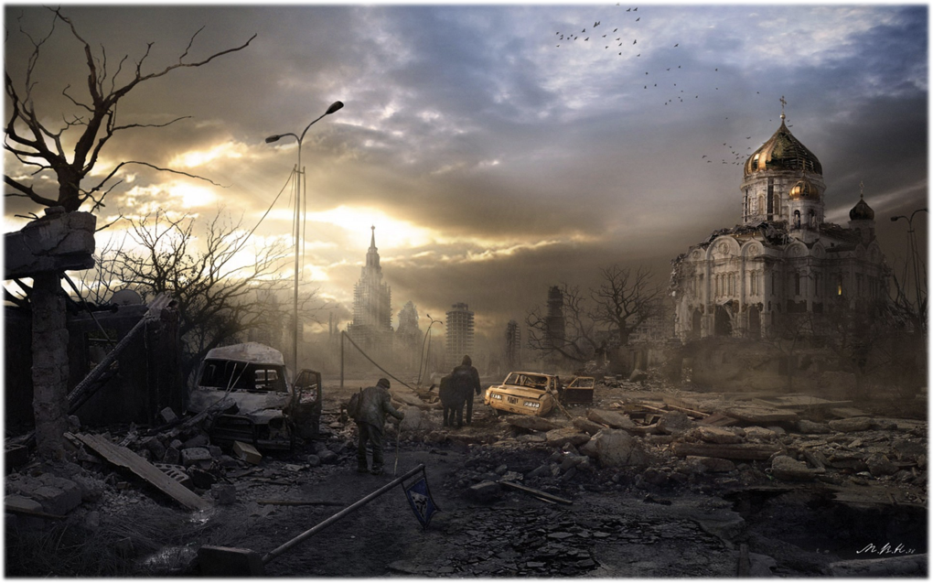
Final Crisis

Slide 43
Babylon

Slide 44
Joshua 3:14

Slide 45
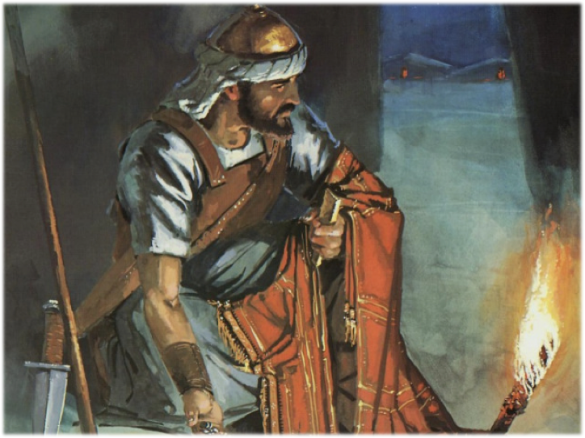
Achan
Joshua 7:20

Slide 46
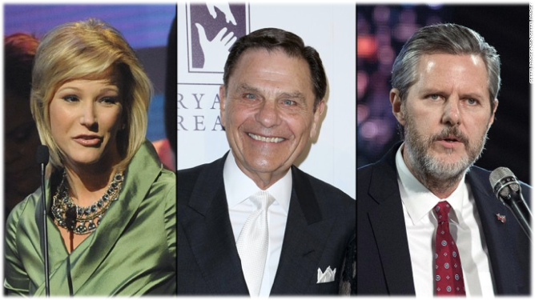
Revelation 13
False Prophet

Slide 47
False Prophet
False Prophet

Slide 48
What is a False Prophet?

Slide 49
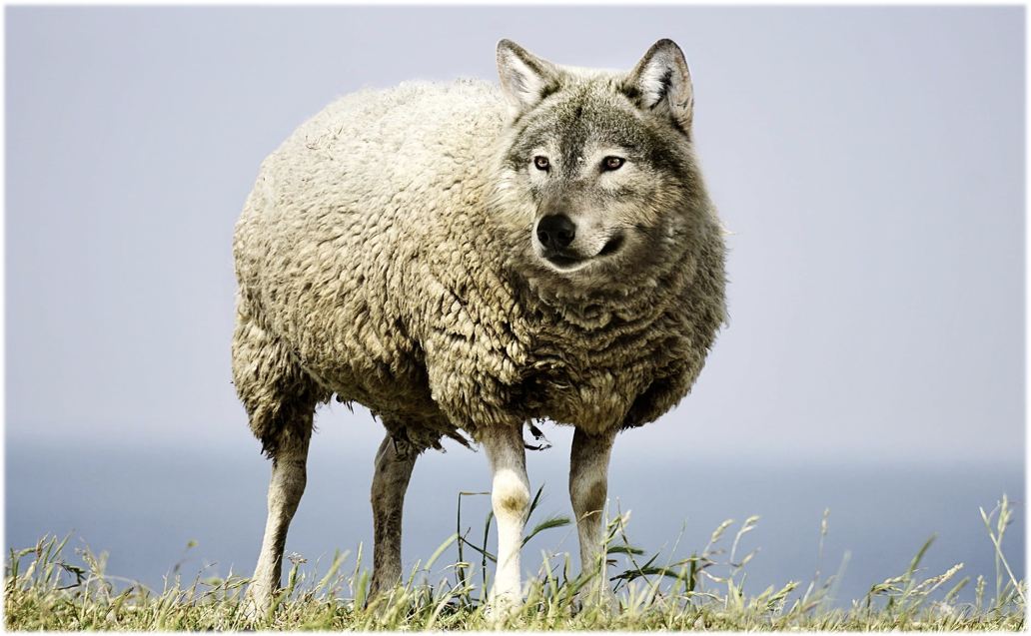
False Prophet
“Beware of false prophets, which come to you in sheep's clothing, but inwardly they are ravening wolves.”

Slide 50
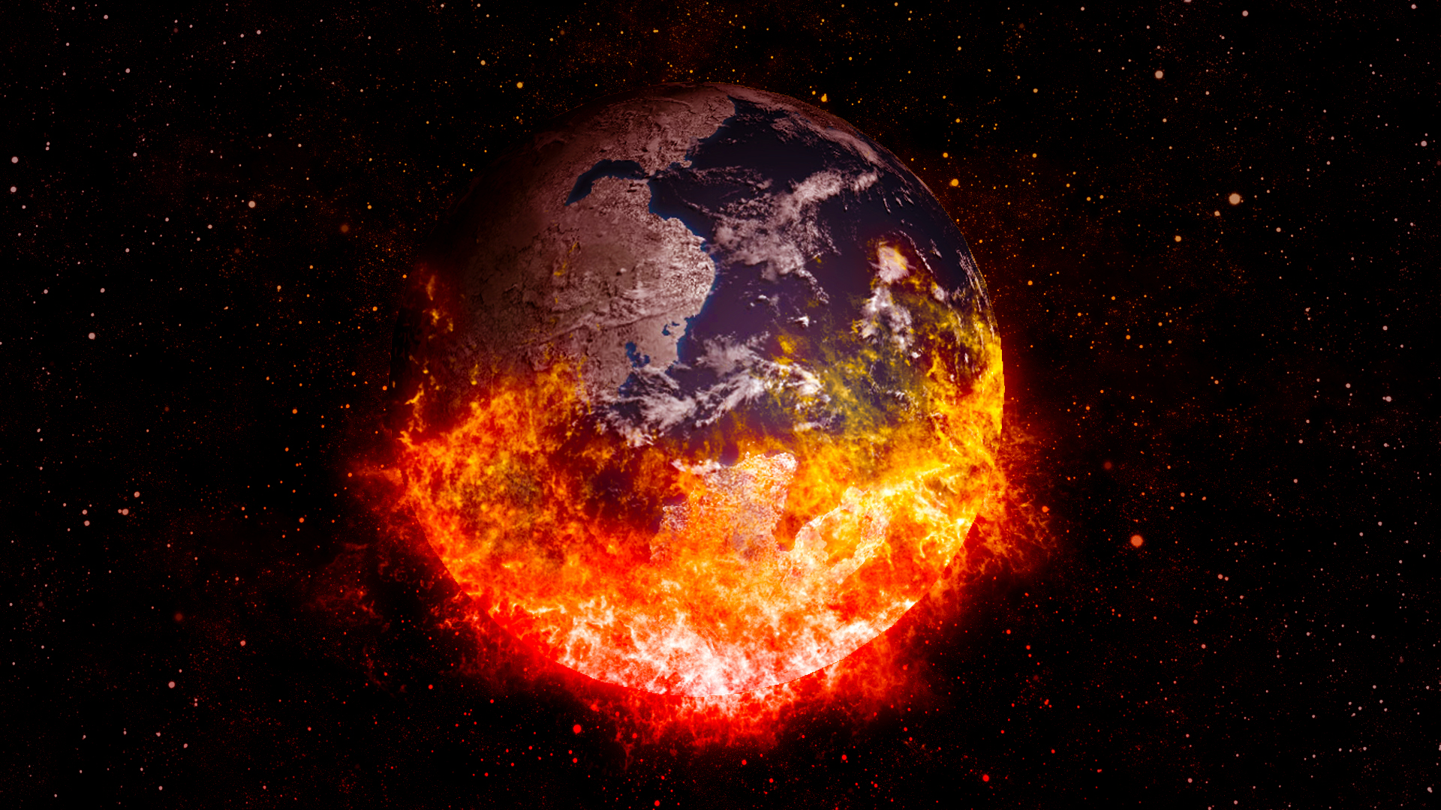
Death
Misery
Unbelief

Slide 51
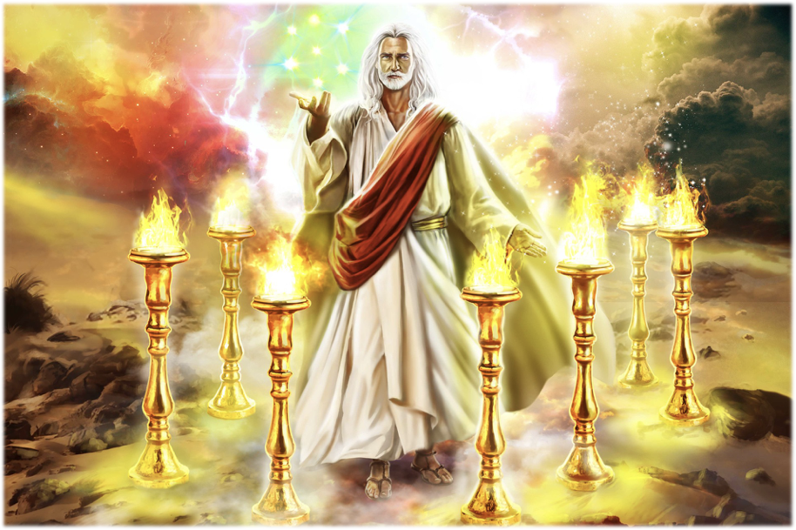
Revelation 1:12-13

Slide 52
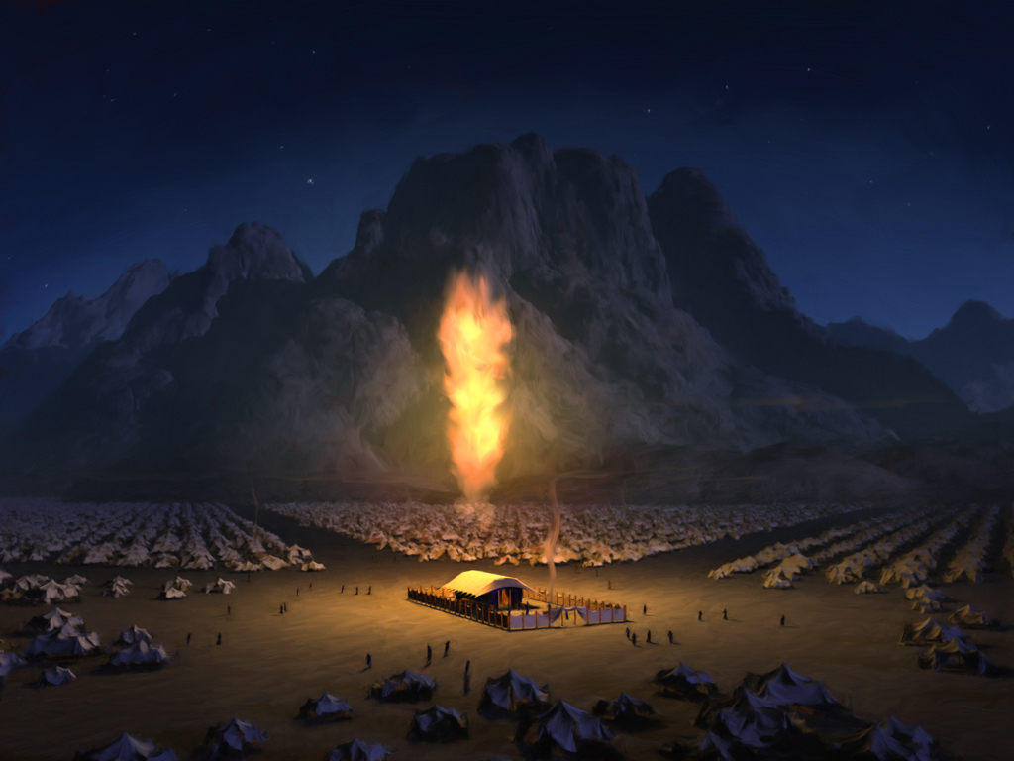

Slide 55
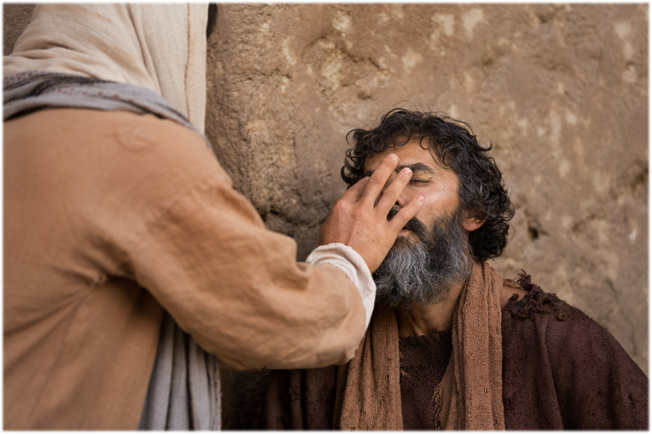

Slide 56
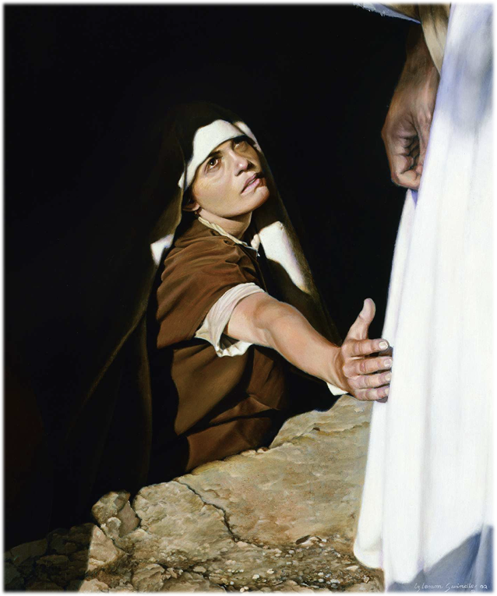

Slide 57
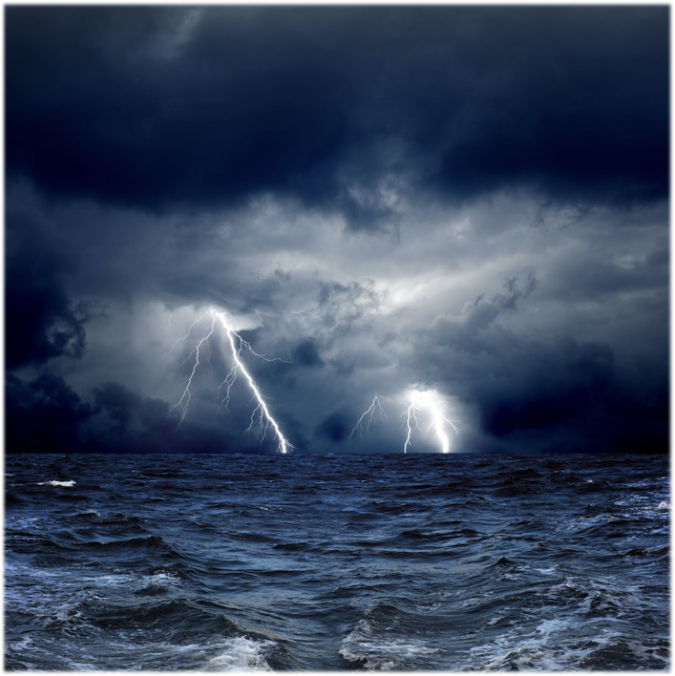

Slide 58
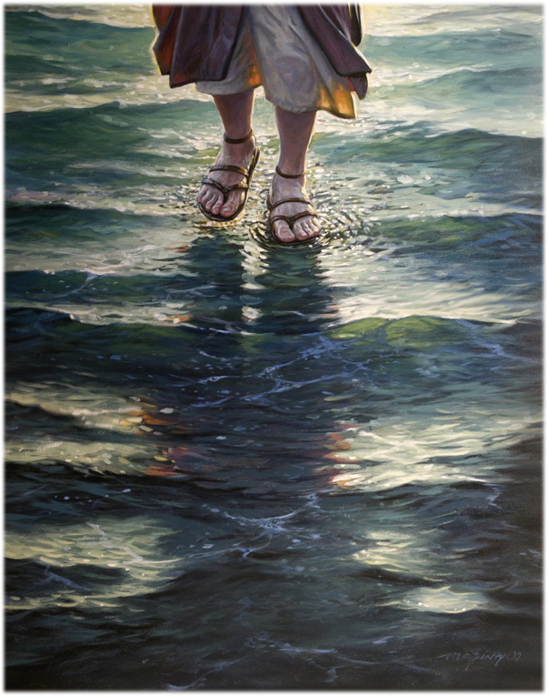

Slide 59
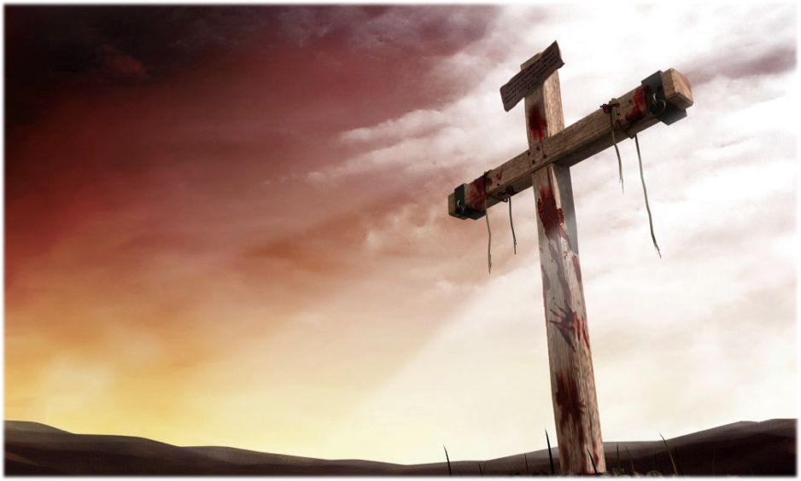

Slide 60
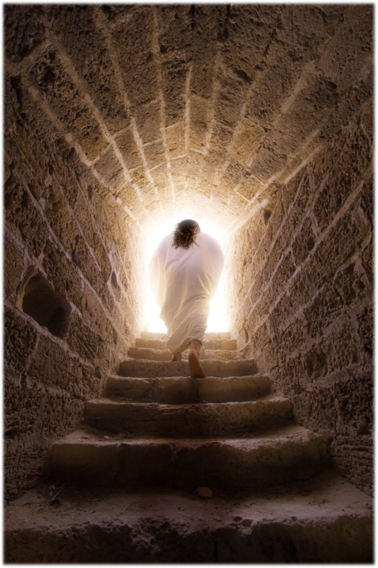
Life
Joy
Faith

Slide 61
Temperance
Goodness
Long-suffering
Love
Meekness
Joy
Faith
Peace
Gentleness

Slide 65
Worldly Dress
Appetite
Bad Movies
Worldly Music
Bad Relationships

Slide 66
Foolishness
Lasciviousness
Wrath
Evil thoughts
An evil eye
Divisions
Covetousness
Pride

Slide 67
End

